Slide 1
Lab 1: Generalized linear models
March 29, 2018

Slide 2
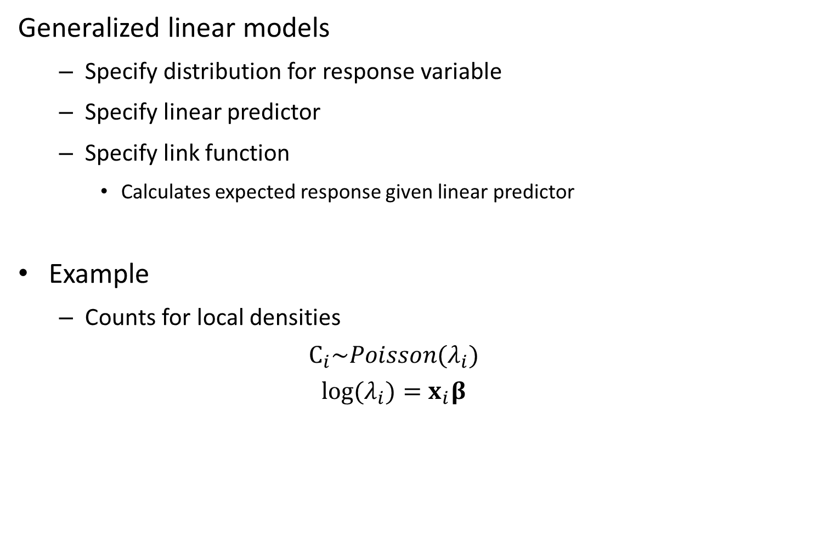
Generalized linear models
Specify distribution for response variable
Specify linear predictor
Specify link function
Calculates expected response given linear predictor
Example
Counts for local densities
$$C_{i}\sim Poisson(λ_{i})$$
$$log⁡(λ_{i})=x_{i}β$$

Slide 3
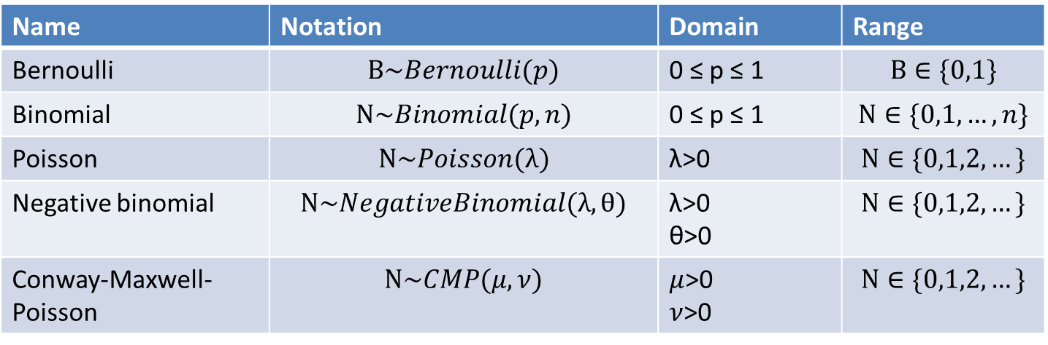
Common distributions for data
Discrete
Name | Notation | Domain | Range
Bernoulli | $$B\sim Bernoulli(p)$$ | 0 ≤ p ≤ 1 | $$B∈\{0,1\}$$
Binomial | $$N\sim Binomial(p,n)$$ | 0 ≤ p ≤ 1 | $$N∈\{0,1,…,n\}$$
Poisson | $$N\sim Poisson(λ)$$ | λ>0 | $$N∈\{0,1,2,…\}$$
Negative binomial | $$N\sim NegativeBinomial(λ,θ)$$ | λ>0 θ>0 | $$N∈\{0,1,2,…\}$$
Conway-Maxwell-Poisson | $$N\sim CMP(μ,ν)$$ | $μ$>0 $ν$>0 | $$N∈\{0,1,2,…\}$$

Slide 4
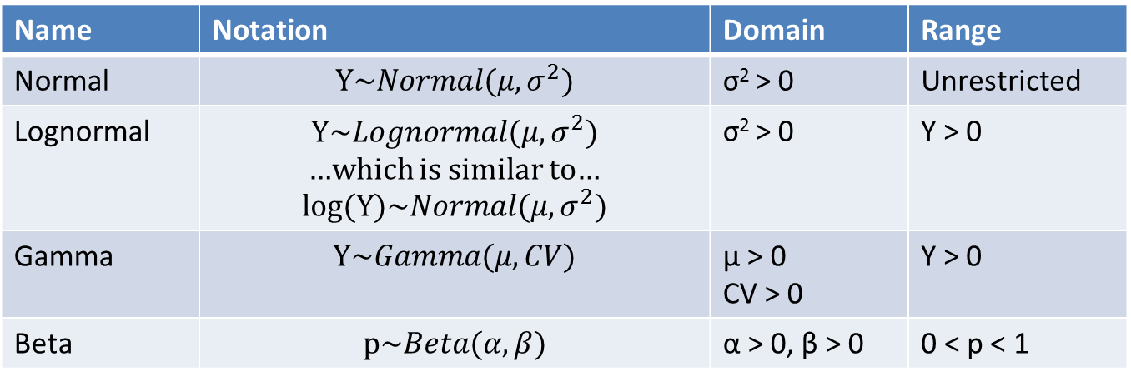
Common distributions for data
Continuous
Name | Notation | Domain | Range
Normal | $$Y\sim Normal(μ,σ^{2})$$ | σ² > 0 | Unrestricted
Lognormal | $$Y\sim Lognormal(μ,σ^{2})$$ …which is similar to… $$log⁡(Y)\sim Normal(μ,σ^{2})$$ | σ² > 0 | Y > 0
Gamma | $$Y\sim Gamma(μ,CV)$$ | μ > 0 CV > 0 | Y > 0
Beta | $$p\sim Beta(α,β)$$ | α > 0, β > 0 | 0 < p < 1

Slide 5
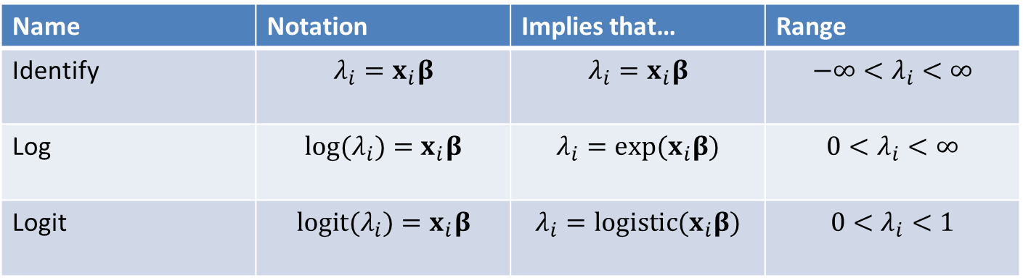
Common link functions
Name | Notation | Implies that… | Range
Identify | $$λ_{i}=x_{i}β$$ | $$λ_{i}=x_{i}β$$ | $$−∞<λ_{i}<∞$$
Log | $$log⁡(λ_{i})=x_{i}β$$ | $$λ_{i}=exp⁡(x_{i}β)$$ | $$0<λ_{i}<∞$$
Logit | $$logit⁡(λ_{i})=x_{i}β$$ | $$λ_{i}=logistic(x_{i}β)$$ | $$0<λ_{i}<1$$

Slide 6
How to chose a distribution for data?
Choice 1 – is it continuous or discrete?
Continuous: normal, lognormal, beta, gamma
Discrete: Bernoulli, binomial, poisson, negative binomial
Choice 2 – what is the range of possible values?
E.g., if discrete:
If is is 0 or 1, then its Bernoulli
If its between 0 and N, where N is the number of trials, then its Binomial
Choice 3 – How flexible do you want it?

Slide 7
How to chose a distribution for data?
Frequent null models:
Binomial
Poisson
Normal

Slide 8
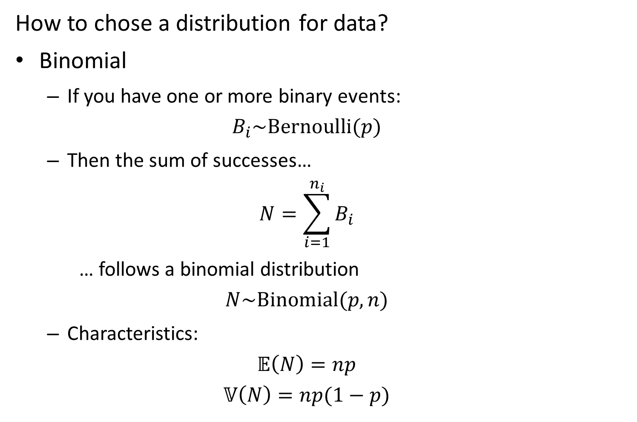
How to chose a distribution for data?
Binomial
If you have one or more binary events:
$$B_{i}\sim Bernoulli(p)$$
Then the sum of successes…
$$N=\sum_{i=1}^{n_{i}}{B_{i}}$$
… follows a binomial distribution
$$N\sim Binomial(p,n)$$
Characteristics:
$$𝔼\left(N\right)=np$$
$$𝕍\left(N\right)=np(1−p)$$

Slide 9
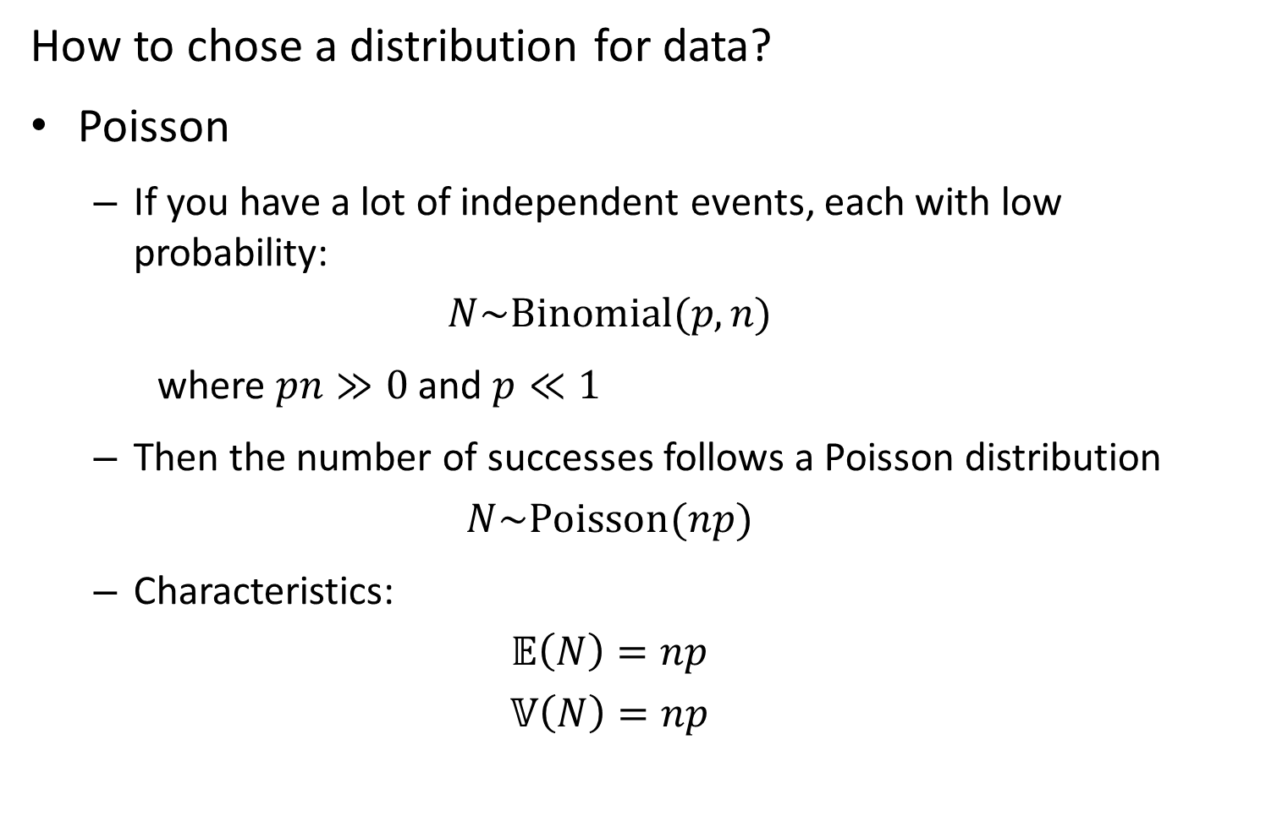
How to chose a distribution for data?
Poisson
If you have a lot of independent events, each with low probability:
$$N\sim Binomial(p,n)$$
where $pn≫0$ and $p≪1$
Then the number of successes follows a Poisson distribution
$$N\sim Poisson(np)$$
Characteristics:
$$𝔼\left(N\right)=np$$
$$𝕍\left(N\right)=np$$

Slide 10
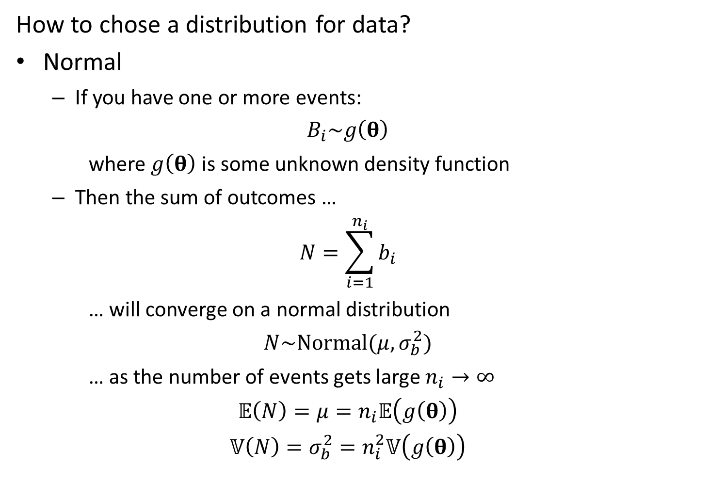
How to chose a distribution for data?
Normal
If you have one or more events:
$$B_{i}\sim g\left(θ\right)$$
where $g\left(θ\right)$ is some unknown density function
Then the sum of outcomes …
$$N=\sum_{i=1}^{n_{i}}{b_{i}}$$
… will converge on a normal distribution
$$N\sim Normal(μ,σ_{b}^{2})$$
… as the number of events gets large $n_{i}→∞$
$$𝔼\left(N\right)=μ=n_{i}𝔼\left(g\left(θ\right)\right)$$
$$𝕍\left(N\right)=σ_{b}^{2}=n_{i}^{2}𝕍\left(g\left(θ\right)\right)$$

Slide 11
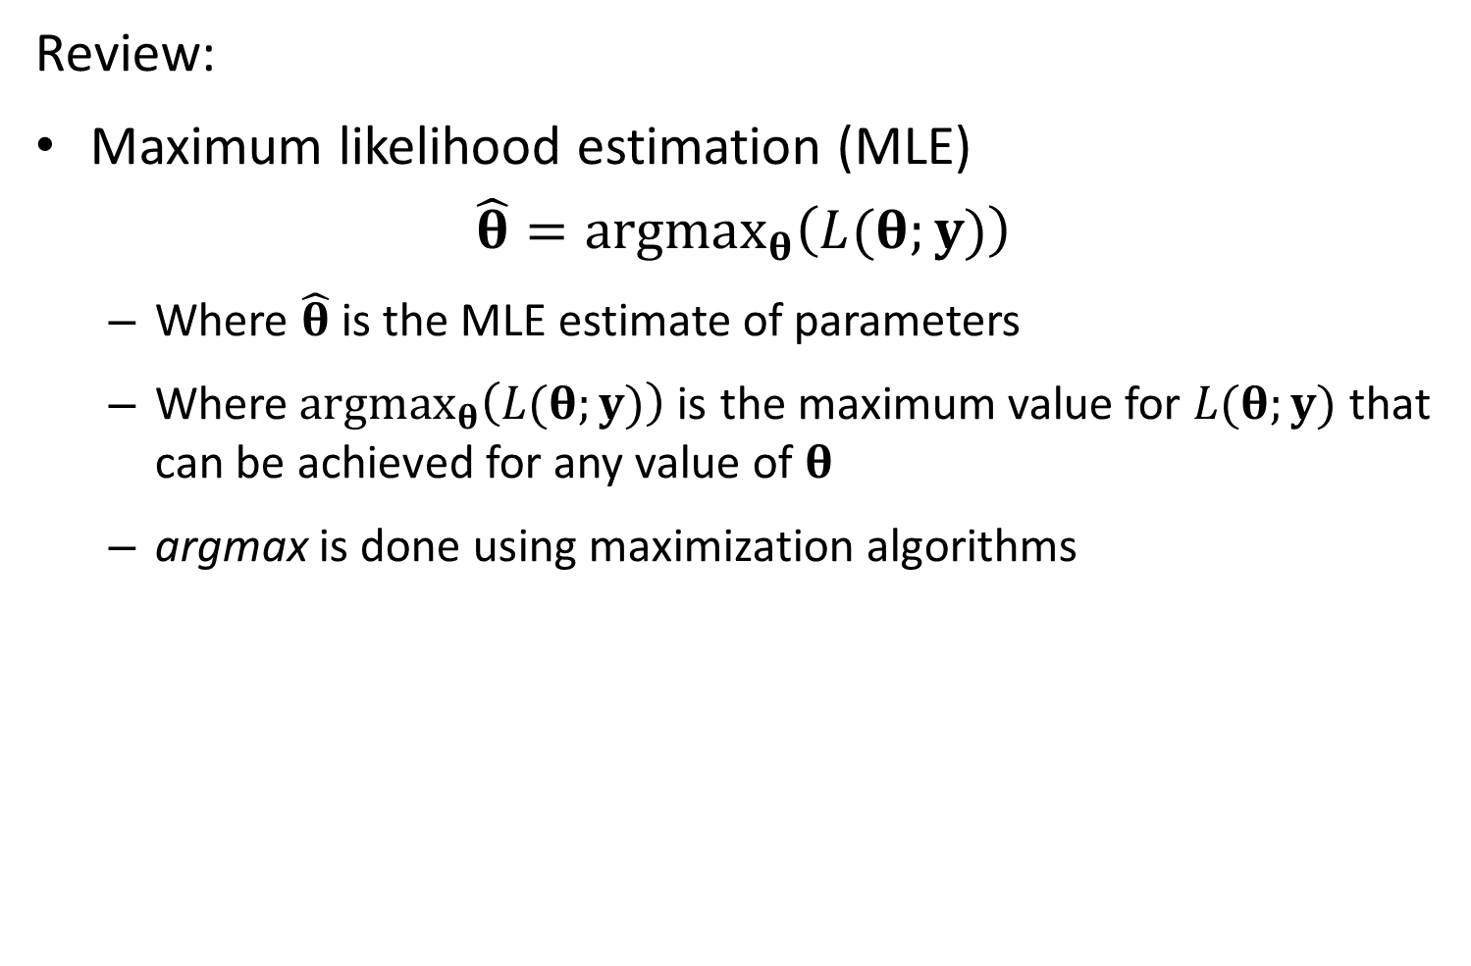
Review:
Maximum likelihood estimation (MLE)
$$\hat{θ}=argmax_{θ}\left(L(θ;y)\right)$$
Where $\hat{θ}$ is the MLE estimate of parameters
Where$argmax_{θ}\left(L(θ;y)\right)$is the maximum value for $L(θ;y)$that can be achieved for any value of $θ$
argmax is done using maximization algorithms

Slide 12
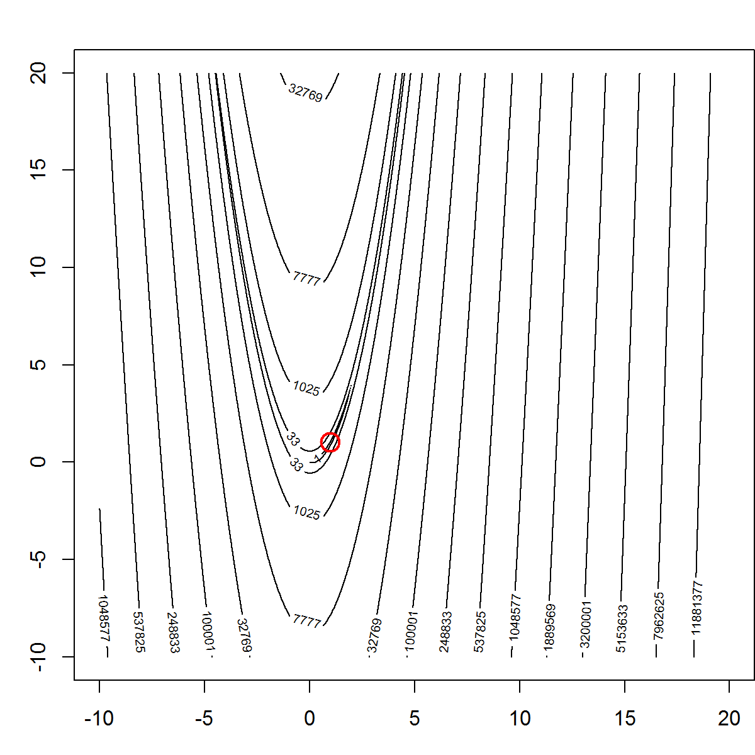
How to maximize the likelihood function
Nonlinear minimizers
Test using Rosenbrook “Banana” function

Slide 13
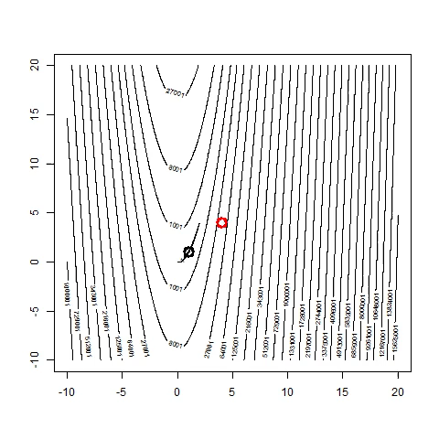
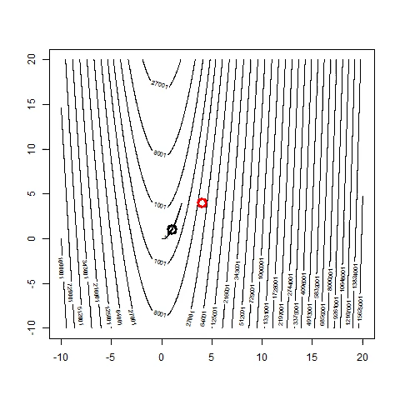
How to maximize the likelihood function
Methods without gradients are slow
Quasi-Newton
Nelder-Mead

Slide 14
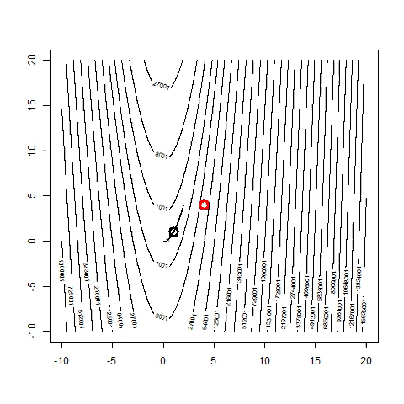
How to maximize the likelihood function
Methods with gradients are much faster!
TMB using Nelder-Mead
Nelder-Mead

Slide 15
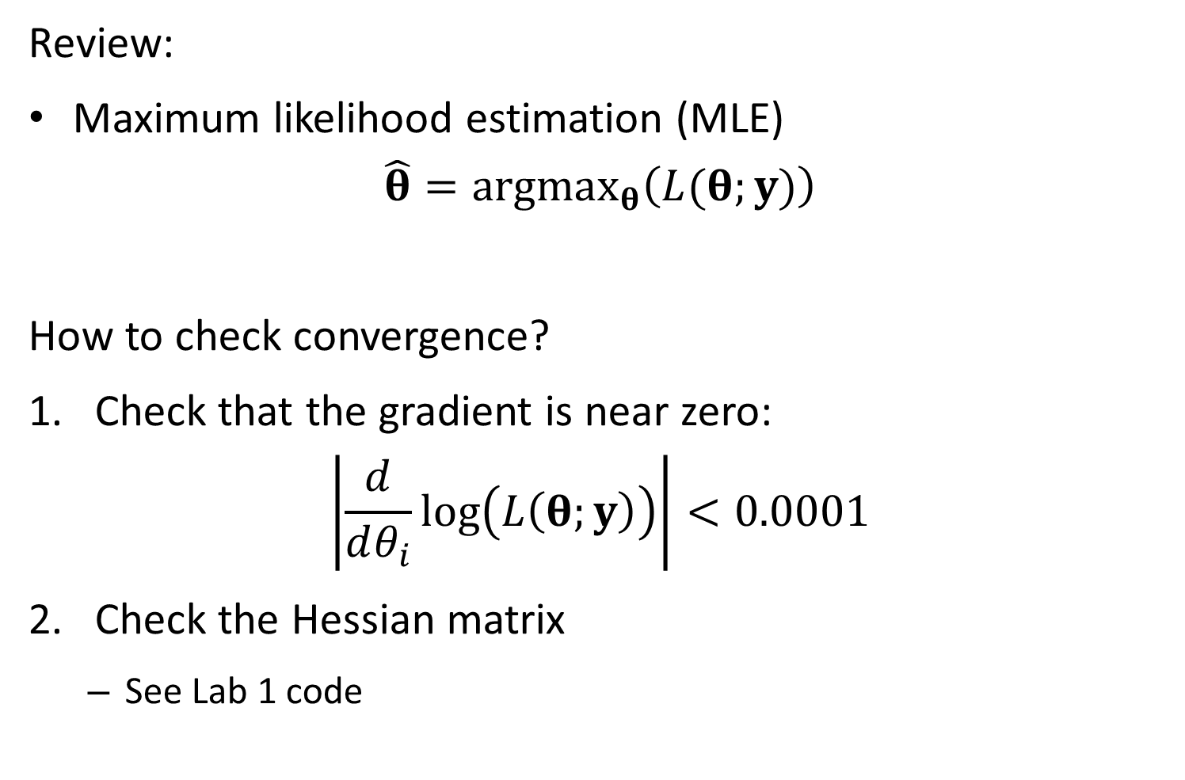
Review:
Maximum likelihood estimation (MLE)
$$\hat{θ}=argmax_{θ}\left(L(θ;y)\right)$$
How to check convergence?
Check that the gradient is near zero:
$$\left|\frac{d}{dθ_{i}}\log\left(L\left(θ;y\right)\right)\right|<0.0001$$
Check the Hessian matrix
See Lab 1 code

Slide 16
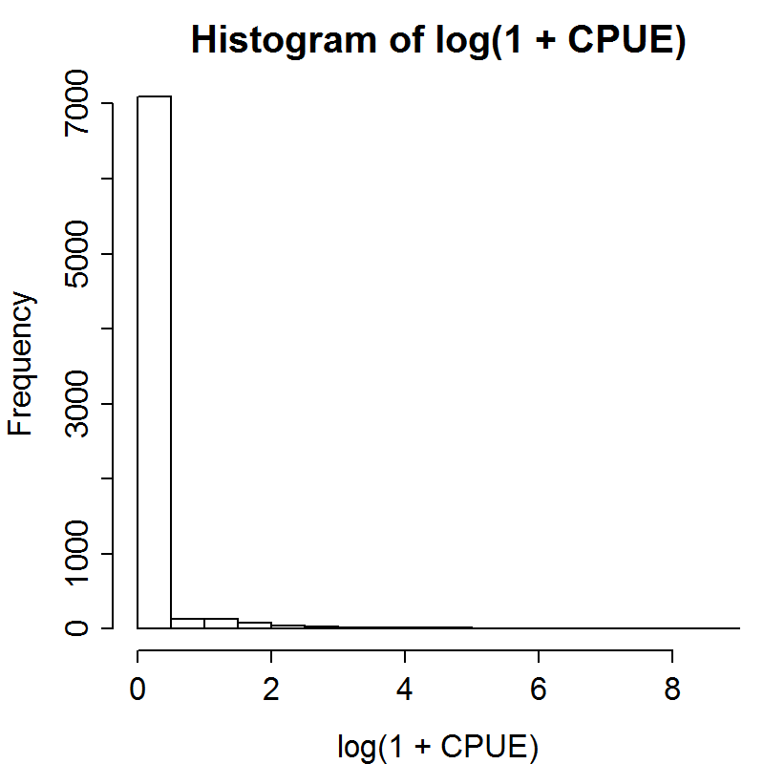
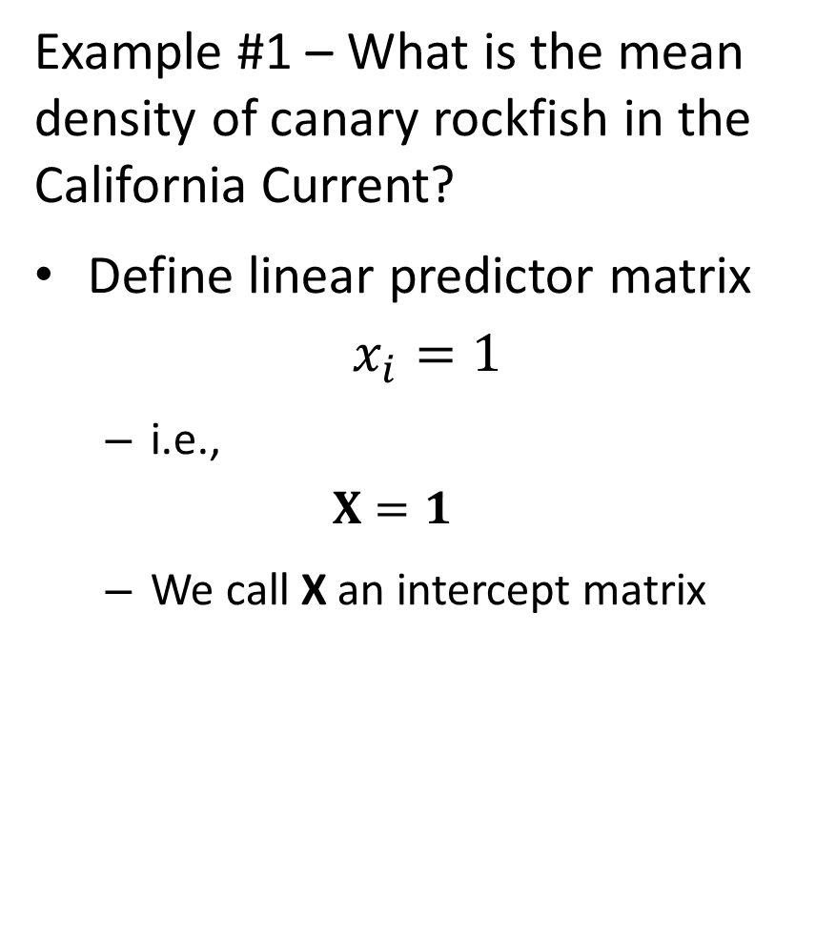
Example #1 – What is the mean density of canary rockfish in the California Current?
Define linear predictor matrix
$$x_{i}=1$$
i.e.,
$$X=1$$
We call X an intercept matrix

Slide 17

Example #1 – What is the mean density of canary rockfish in the California Current?
Issues:
Contains many samples where $c_{i}=0$
Samples where $c_{i}>0$ are not whole numbers

Slide 18
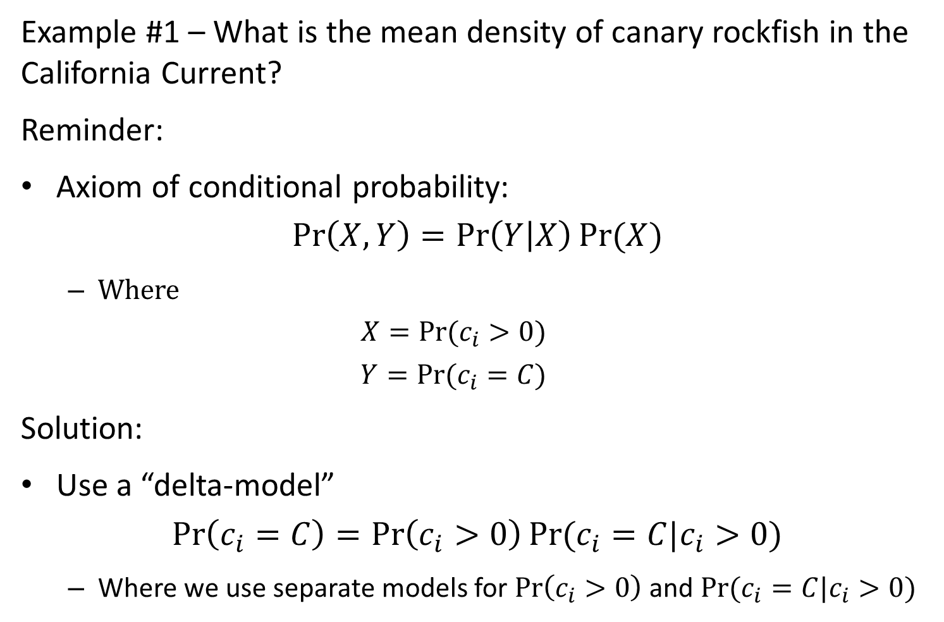
Example #1 – What is the mean density of canary rockfish in the California Current?
Reminder:
Axiom of conditional probability:
$$\operatorname{Pr}\left(X,Y\right)=\operatorname{Pr}\left(Y | X\right)Pr⁡(X)$$
Where
$$X=Pr⁡(c_{i}>0)$$
$$Y=Pr⁡(c_{i}=C)$$
Solution:
Use a “delta-model”
$$\operatorname{Pr}\left(c_{i}=C\right)=\operatorname{Pr}\left(c_{i}>0\right)Pr⁡(c_{i}=C|c_{i}>0)$$
Where we use separate models for $\operatorname{Pr}\left(c_{i}>0\right)$ and $Pr⁡(c_{i}=C|c_{i}>0)$

Slide 19
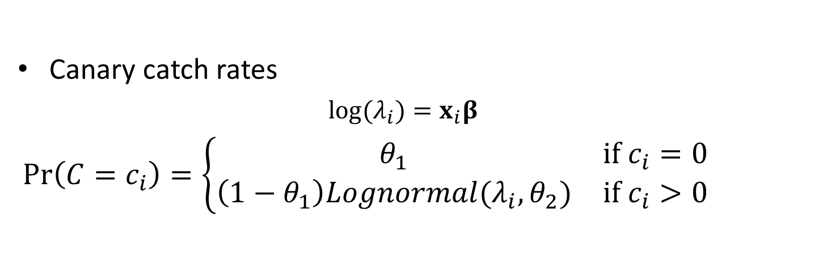
Generalized linear models
Specify one for encounter/non-encounter
Species another for positive catch rates
Canary catch rates
$$log⁡(λ_{i})=x_{i}β$$
$$\operatorname{Pr}\left(C=c_{i}\right)=\left\{\begin{matrix}θ_{1} & if c_{i}=0 \\ \left(1−θ_{1}\right)Lognormal(λ_{i},θ_{2}) & if c_{i}>0\end{matrix}\right.$$

Slide 20

Hint
If:
$$\operatorname{Pr}\left(c_{i}=C\right)=\left\{\begin{matrix}θ_{1} & if c_{i}=0 \\ (1−θ_{1})Lognormal(c_{i}=C|λ_{i},θ_{2}) & if c_{i}>0\end{matrix}\right.$$
Then:
$$log⁡(\operatorname{Pr}\left(c_{i}=C\right))$$
$$=\left\{\begin{matrix}log⁡(θ_{1}) & if c_{i}=0 \\ \log\left(1−θ_{1}\right)+log⁡(Lognormal\left(c_{i}=C|λ_{i},θ_{2}\right)) & if c_{i}>0\end{matrix}\right.$$

Slide 21
[Work on TMB code in groups of 2 for 20 minutes]

Slide 22
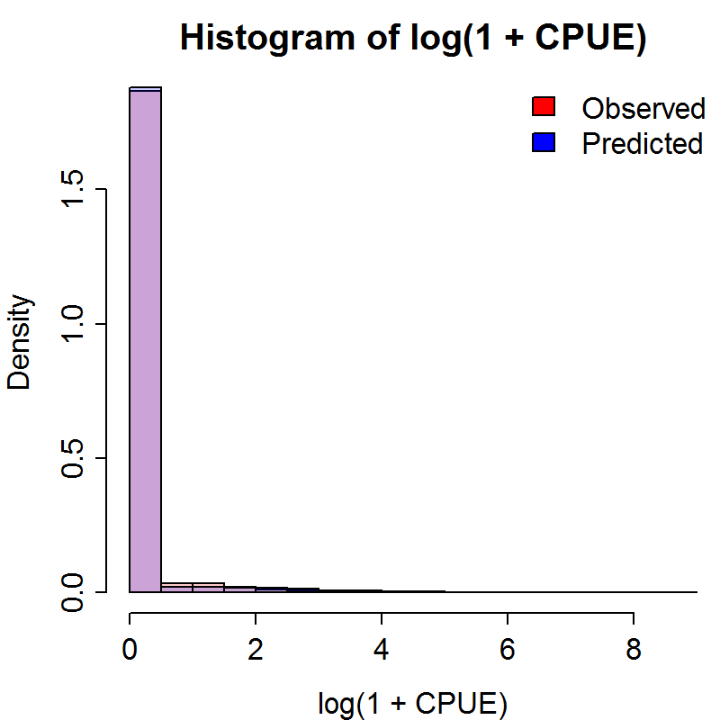
Conclusion
Decent fit…

Slide 23
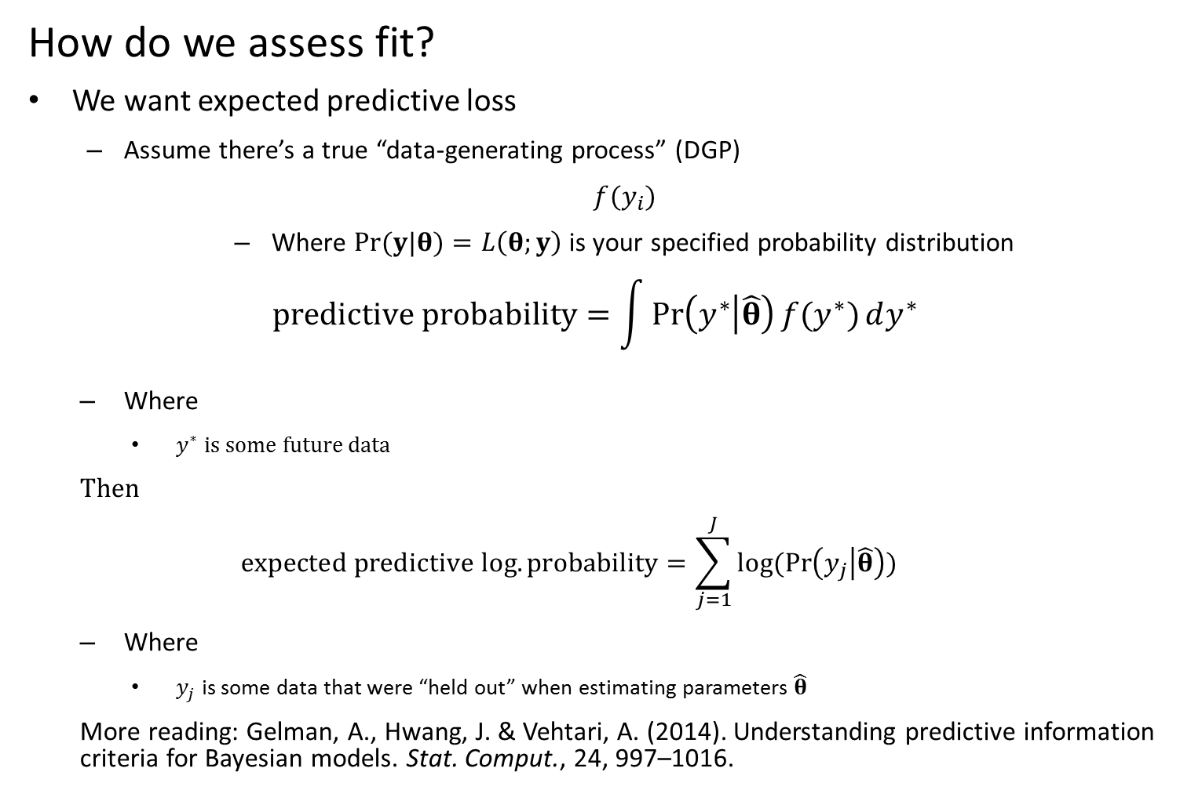
How do we assess fit?
We want expected predictive loss
Assume there’s a true “data-generating process” (DGP)
$f(y_{i})$
Where $Pr(y|θ)=L\left(θ;y\right)$ is your specified probability distribution
$$predictive probability=\int{Pr\left(y^{∗} | \hat{θ}\right){f(y^{∗})}dy^{∗}}$$
Where
$y^{∗}$ is some future data
Then
$$expected predictive log.probability=\sum_{j=1}^{J}{log⁡(Pr\left(y_{j} | \hat{θ}\right))}$$
Where
$y_{j}$ is some data that were “held out” when estimating parameters $\hat{θ}$
More reading: Gelman, A., Hwang, J. & Vehtari, A. (2014). Understanding predictive information criteria for Bayesian models. Stat. Comput., 24, 997–1016.

Slide 24
How do we assess fit?
K-fold crossvalidation
Divide data set into K even partitions
Calculate predictive probability for 1st partition
For each piece K, fit the model to all data except data in that partition
Calculate the predictive probability of data in partition K using this model
Record predictive probability
Repeat step 2 for all K partitions
Chose the model with the highest predictive probability

Slide 25
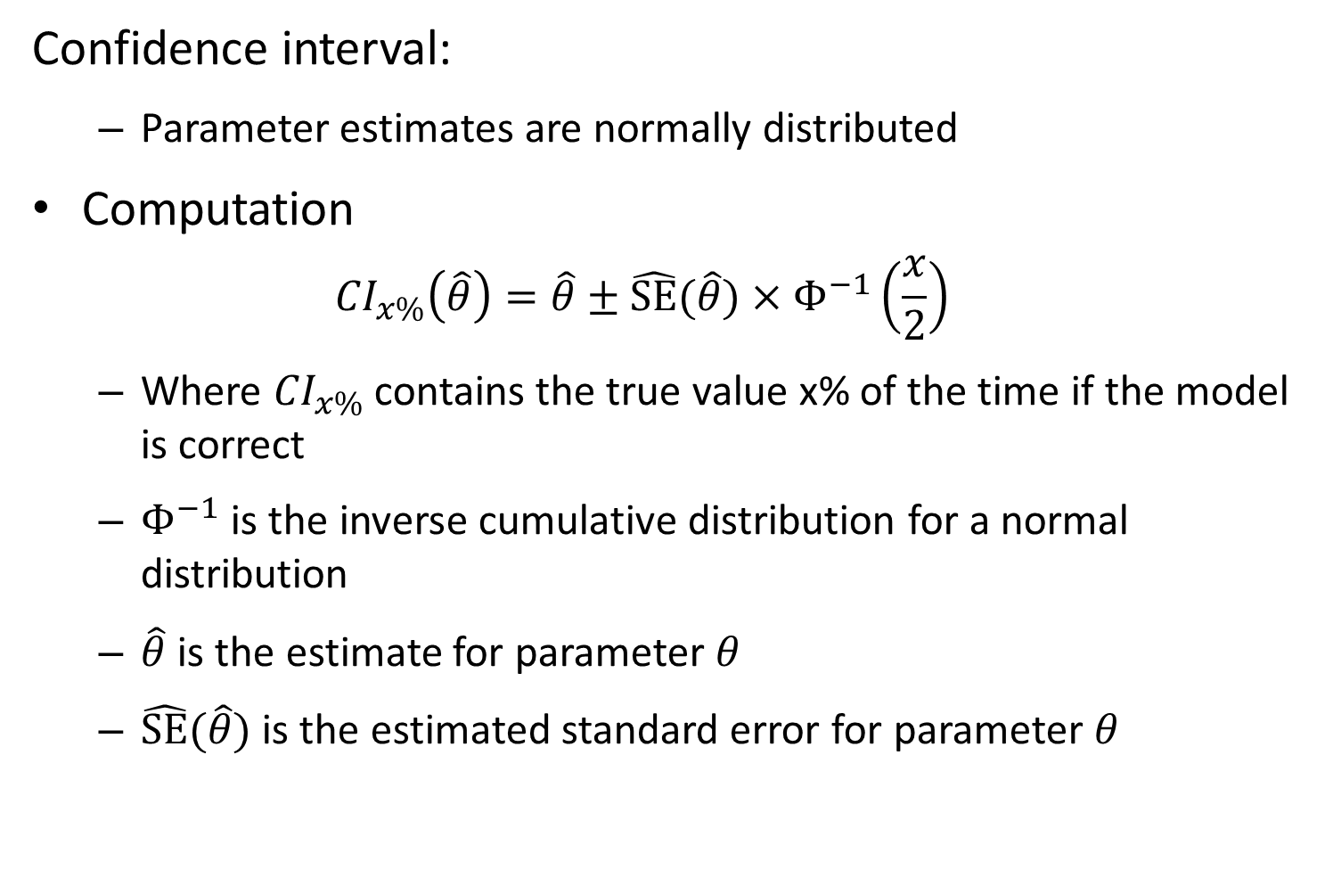
Confidence interval:
Parameter estimates are normally distributed
Computation
$${CI}_{x\%}\left(\hat{θ}\right)=\hat{θ}±\hat{SE}(\hat{θ})×Φ^{−1}\left(\frac{x}{2}\right)$$
Where ${CI}_{x\%}$ contains the true value x% of the time if the model is correct
$Φ^{−1}$ is the inverse cumulative distribution for a normal distribution
$\hat{θ}$ is the estimate for parameter $θ$
$\hat{SE}(\hat{θ})$ is the estimated standard error for parameter $θ$

Slide 26
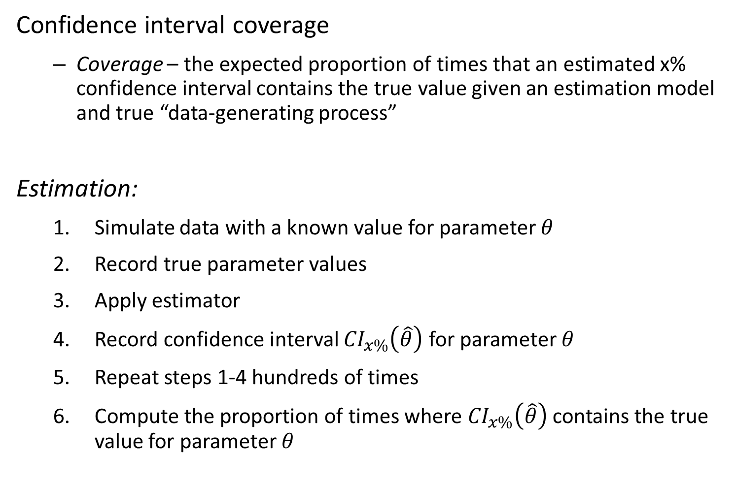
Confidence interval coverage
Coverage – the expected proportion of times that an estimated x% confidence interval contains the true value given an estimation model and true “data-generating process”
Estimation:
Simulate data with a known value for parameter $θ$
Record true parameter values
Apply estimator
Record confidence interval ${CI}_{x\%}\left(\hat{θ}\right)$ for parameter $θ$
Repeat steps 1-4 hundreds of times
Compute the proportion of times where ${CI}_{x\%}\left(\hat{θ}\right)$ contains the true value for parameter $θ$

Slide 27
[Work on TMB code in groups of 2 for 20 more minutes]

Slide 28
Homework assignment:
Due at beginning of Lab #2
Must turn in your own code
Cannot cut-paste any code from other students
You can hand-write your own code while working with someone else, or looking at my example code

